Slide 1
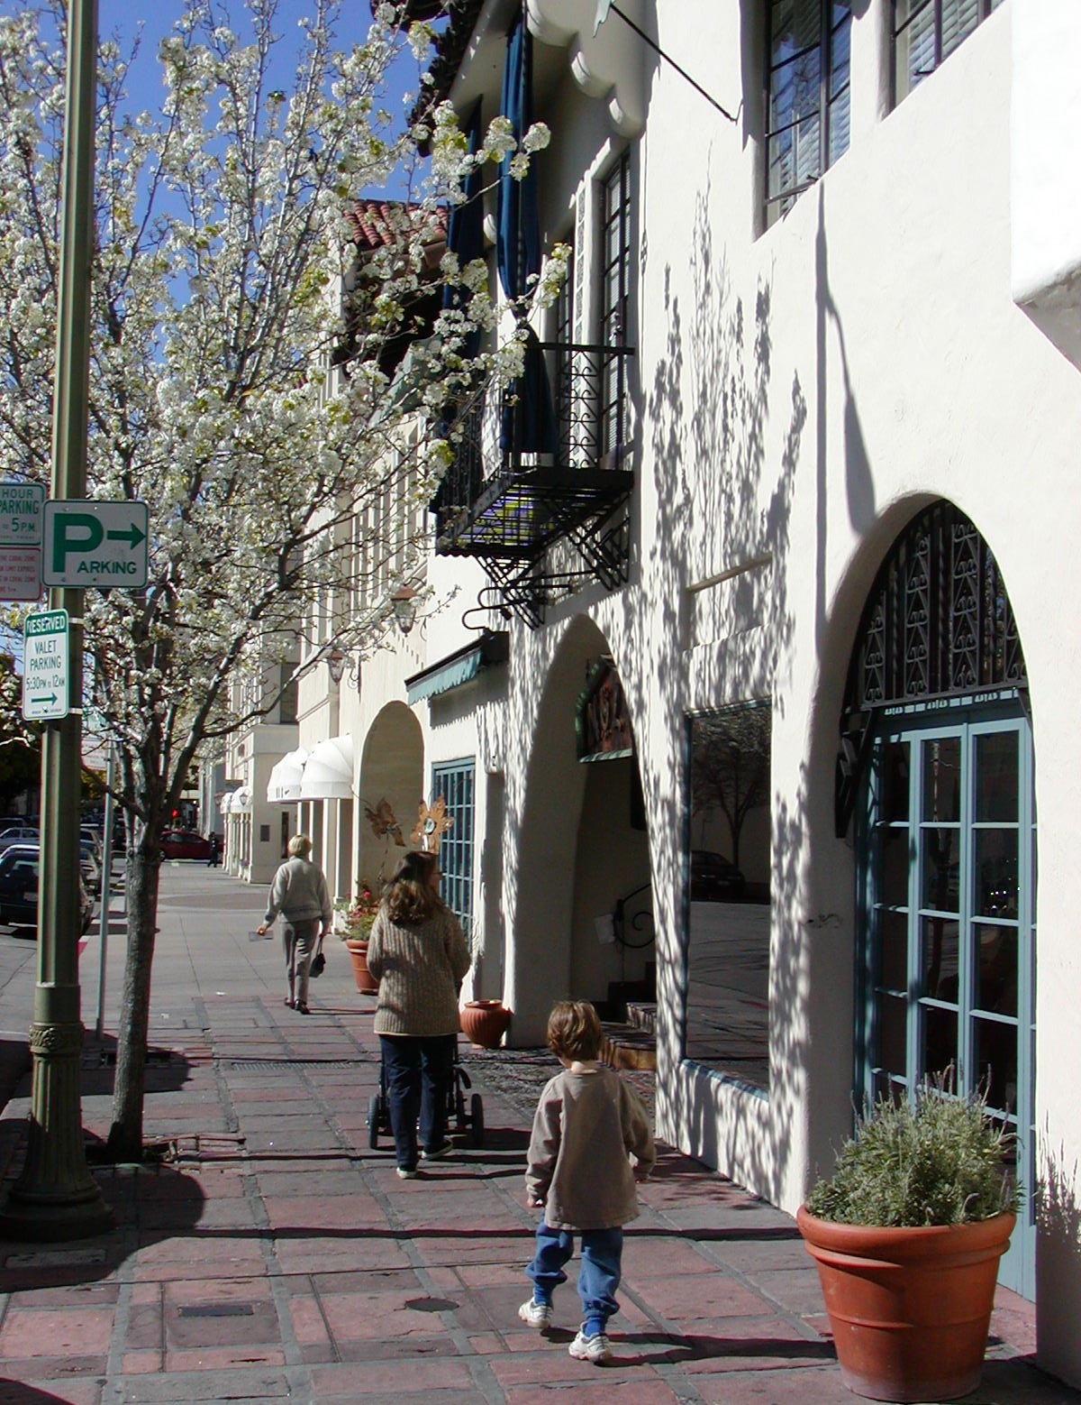
A “Toolkit” of Traffic Reduction Strategies
Regulating Parking at Developments
Improving Transportation Choices
Notes:
1.5 hour meeting
We’ll start with the basics on the study – study area, scope of work, draft goals
Then, get a little initial input
Then, I’ll walk through the existing conditions analysis that we have done and talk through key takeaways from that
For the bulk of our time together, we’ll discuss a number of potential strategies

Slide 2
A toolkit of traffic reduction strategies
Parking
Use residential parking permit districts to protect residents
Unbundle parking costs at residences, offices, etc.
Require parking cash out
Improving transportation choices
Require on-site carshare cars
Require on-site bikeshare bikes
Require free (deep-discount group) transit passes for residents & employees
Require formation of a Transportation Management Association
Require provision of free shuttles to Caltrain & other destinations

